Slide 1
Fantel Problem Statement Discussion
Weiqiang Cheng - China Mobile

Slide 2
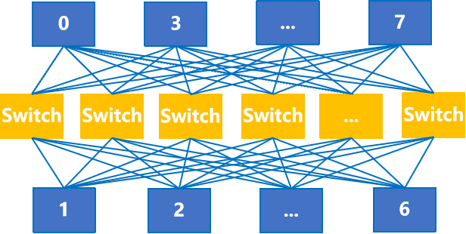
Network for AI: Overview
Network for AI consists of three parts: Scale-Up network, Scale-Out network, and DCI network, which together form a network with over 100,000 cards.
1
AI DCI Network
Mesh
Port capacity expands from 400Gbps to virtual pipeline 3.2Tbps,
lossy network
Cluster A
2
Scale-Out Network
Fat Tree
Over 10,000 GPU cards, ultra-high bandwidth, ultra-low latency and jitter,
lossy network
Cluster B
3
Scale-Up Network
Full mesh
Expands from one node with 8 cards to a super node with 128 cards,
bandwidth from 56GBps to 800GBps
2

Slide 3
Traffic Model in AI Datacenters
The traffic pattern of networks for AI is significantly different from that of networks for general computing.
AI Datacenters
one iteration of collective communication
1-100Gbps
Start computing
Datacenters
Flow number
10k-100K
AI flow 1
Bandwidth of a single flow (Gbps)
Flow number
Datacenters
AI flow N
<<1Gbps
AI Datacenters
<<10K
GPU waiting time
Time (ms)
Time (ms)
Time (ms)
Per-Flow Characteristics
AI Computing:
High bandwidth (1-100Gbps), periodic bursts, long-lived flows
General Computing:
Low bandwidth (<<1Gbps), random micro-bursts, short-flow dominated
Flow Number
AI Computing:
Relatively stable (typically <10K)
General Computing:
Larger variable range (typically 10K-100K)
Communication Behavior
AI Computing:
Collective communication with inter-flow synchronization
General Computing:
Point-to-point communication without synchronization
3

Slide 4
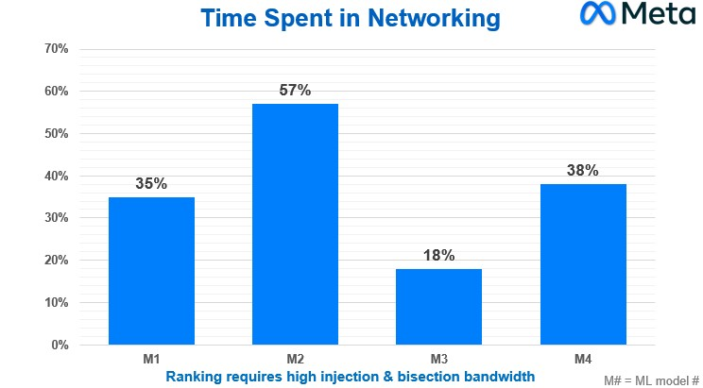
Network Challenges in AI Data Center
Challenge 1: Large-scale training network
100 thousands of GPUs with high-speed interconnectivity
Thousands of RDMA QP connections
Access bandwidth ≥ 100Gbps
Challenge 2: High-performance requirements
Sensitivity to packet loss
Significant impact from latency and jitter
Sub-millisecond fault recovery
2022 OCP keynote by Alexis Bjorlin, VP, Infrastructure at Meta
Traditional network designs result in low bandwidth utilization, significant tail latency effects, and complex system designs. Network performance becomes a bottleneck in improving the efficiency of AI training.
4

Slide 5
Trigger for Fantel
AI-Driven Network Demands
AI applications such as model training and inference require networks with lower latency, faster failure recovery, and adaptive behavior. These demands call for more frequent, flexible, and detailed notification mechanisms to convey network state—supporting faster reroute, congestion response, and load balancing.
Network bandwidth increases to support AI workloads, the tolerance for notification overhead also improves, enabling richer signaling without significant impact on performance.
Need for Unified Notification
Considering multiple new notification requirements, which may differ in format, scope, and function. This leads to redundancy, integration complexity, and limited interoperability. To improve efficiency and consistency, there is a potential need to unify the design of fast notification mechanisms. FaNTEL aims to provide this unified framework to streamline operations across diverse network scenarios.
5

Slide 6
Application Areas for Fantel
Based on the Use cases, Fantel is supposed to be used in the following area:
Load Balancing: Enables rapid dissemination of network state to assist in balancing traffic across multiple paths, improving utilization and responsiveness.
[draft-cheng-rtgwg-adaptive-routing-framework]
[draft-cheng-rtgwg-enhanced-ecmp]
Protection: Facilitates fast awareness of link or node failures, supporting quicker protection switching and reduced traffic loss.
[draft-liu-rtgwg-path-aware-remote-protection]
Flow Control: Helps inform upstream nodes of downstream congestion or performance degradation, enabling timely traffic shaping or rate adjustment.
[draft-zzhang-rtgwg-router-info]
Capability Announcement: Supports lightweight and flexible notification of node or service capabilities (e.g., processing features or queue models), which may not be efficiently handled by existing routing protocols.
Fantel
Load Balancing
Protection
Flow Control
Capability Announcement
6
Notes:
问题的summary：
Topology: dragon-fly (基于mesh的网络) 通算：百ms/50ms
大象流比较多：
拓扑规则较为简单，流量流向固定，多路径
无损的需求：lossless，switchover的时间，notification敏捷
BGP收敛效率不足
如果单独进行设计，互通可能存在问题

Slide 7
Problem Statement #1
Multiple application areas pose challenges to the notification mechanism:
No independent protocol standard for Notifications
the method and approach to implementing Fantel may vary. This can lead to compatibility and interoperability issues among different vendors.
Latency and delay
Fantel involves the exchange of notifications and updates between network devices to detect and react to congestion. The speed and frequency of notifications can affect the performance of the network.
Limited scalability
notification may face scalability challenges when applied to large-scale networks with numerous interconnected devices.
Exp: Notifications for Adaptive Routing
Local link congestion needs to be announced so that remote routers can promptly switch paths. Should not depend on existence of other messages for piggybacking. Sent towards the resolving routers only, does not waste bandwidth on other links...
１
２
Source
Group
３
４
9
10
Dest
Group
11
12
D
7

Slide 8
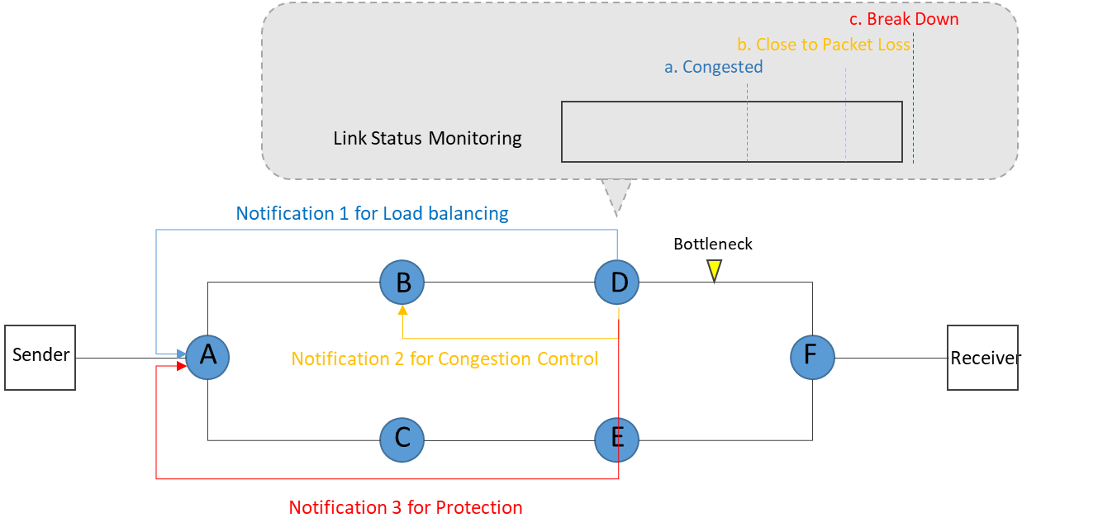
Notification Procedure
Different Scenario Share the similar Notification Procedure:
Triggering Mechanism for Message Sending: A mechanism that detects significant network changes (e.g., link utilization thresholds, delay spikes, packet loss) and initiates the sending of fast notification messages.
Fast Notification Messages: Lightweight messages that convey state changes (such as traffic or network failure events) from one node to others.
Notification Propagation Mechanism: A reliable and efficient way to disseminate notifications quickly throughout the network.
Action after Receiving the Notification: An action (such as rerouting traffic or applying flow control) once the notification is received.
8

Slide 9
Problem Statement #2
The existing notification mechanism lacks a unified standard or solution in the following aspects:
Information Model
requests to define what kind of information is requested in the process of notification. A good information model ensures consistency, extensibility, and interoperability across vendors and implementations.
Notification Encoding and Encapsulation
refers to the encoding and syntax of the notification message—how the information model is translated into bits in the packet.
with existing protocol (for example: IGP, BGP, …) or new transport message
Notification Propagation and Scope
refers to how far and where the notification is sent, and under what policies. Some events are local (only need neighbors to know), others are network-wide (require multiple nodes to act)
Control Signaling and management for Notification
Necessary control signaling extension and management configuration to deploy notification
9

Slide 10
Next Step
With the existing efforts from different scenario, work together to define the notification mechanism
10

Slide 11
Thanks

Slide 12
Notification Information Model
Notification messages must provide enough information to convey relevant network conditions, which may include:
Network State Information: Metrics such as interface status, delay measurements, packet loss ratios, queue depth, or congestion indicators. The applicable granularity may depend on whether the information is interface, path, or flow-specific.
Optional Capability Advertisement: Nodes may include information about their supported notification handling capabilities or processing constraints to allow the receiver to make more informed decisions.
Background Information may also be requested to cover the whole notification process
Example: Background Information model
Local information model
e.g. Port Failure, Congestion …
Network information model
e.g. On Path Information, Topology Information ….
Routing decision information
e.g. Reroute, ECMP (Equal-Cost Multi-Path) Mode …
12

Slide 13
Notification Format
Considerations:
Flexibility: The format should be sufficiently flexible to accommodate diverse notification requirements across various scenarios, including link failures, congestion events, SLA violations, and service-specific triggers. This ensures broad applicability in both traditional and emerging network environments.
Extensibility: Define a base structure with optional fields or modular extensions (e.g., capabilities, flow types).
Security Support: Include provisions for authentication (e.g., message signing, MAC) and privacy (e.g., field-level encryption).
13

Slide 14
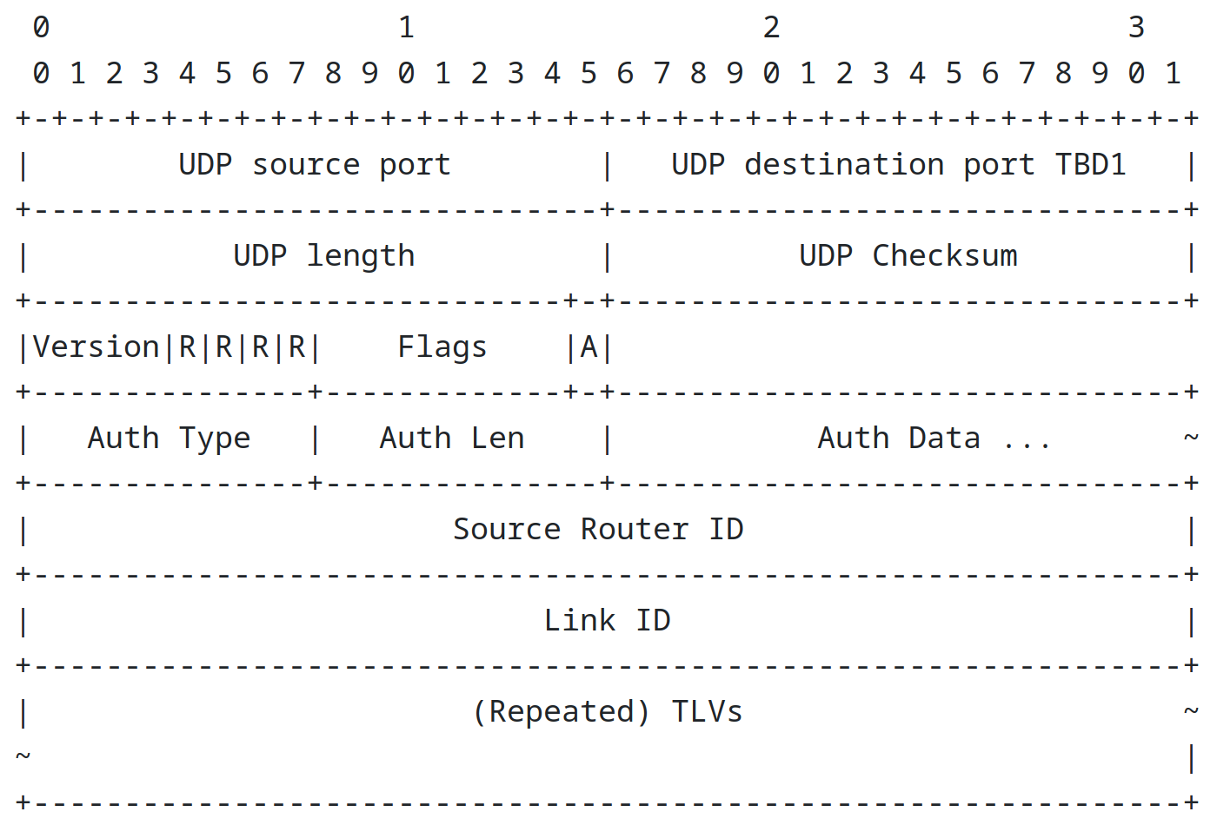
Notification Format
Possible Options:
Notification with Explicit Format: Typically, Type-Length-Value structure allowing flexible expression of notification content while supporting forward compatibility.
OPAQUE-Based Notification Structure: A data and format structure that is flexibly defined based on application requirements and remains opaque to intermediate forwarding devices, meaning the network nodes do not need to interpret or process its content.
Example: Message format for advertising router information in [draft-zzhang-rtgwg-router-info]
If additional information needs to be advertised, new TLVs may be defined without using sub-TLVs to allow efficient encoding of additional information, or with sub-TLVs to allow flexibility but at the cost of processing complexity.
14

Slide 15
Notification Propagation and Scope
The delivery scope and propagation mechanism of notifications must strike a balance between speed and scalability:
Point-to-Point (P2P): Delivery to a directly connected neighbor or designated next-hop.
Point-to-Multipoint (P2MP): Dissemination to a selected set of nodes, for example along a service or forwarding path.
Scoped Flooding or Domain-wide Broadcast: Delivery to all nodes in a defined region or domain. Suitable for critical events, though special attention must be paid to control overhead and duplication.
Example of P2P in [draft-liu-rtgwg-path-aware-remote-protection]
Remote Repair Node
Intermediate Node
Local Detection Node
Fault
R1
R2
R3
X
Destination
Local detection node sends failure notification messages to the remote repair node.
Intermediate node delivers the failure notification messages from the local detection node to the remote repair node.
(multiple hops)
Failure Notification Messages
Repair Path
15

Slide 16
Control Signaling and Management for Notification
In addition to defining notification formats and semantics, effective deployment of notification also requires control signaling mechanisms and management frameworks to support configuration, coordination, and capability negotiation.
Key considerations may include:
Notification Sender and Notification Receiver configuration: How notification sources and intended receivers are configured and identified, possible including per-node or per-service granularity.
Connection establishment or connectionless discovery: Mechanisms for notification sources to connect or discover to potential receivers, especially in network with different vendors.
Capability negotiation: A process for exchanging supported notification types, formats, and transport modes, ensuring compatibility between endpoints.
Policy and scope management: Control interfaces to define which events should trigger notifications, the propagation scope, and rate limiting or filtering policies.
These control-plane extensions are essential for scalable, secure, and interoperable deployment of notification in both centralized and distributed network architectures.
16

